Slide 1
Market share/Sales/Dealer/LTA Dashboard Program

Slide 2
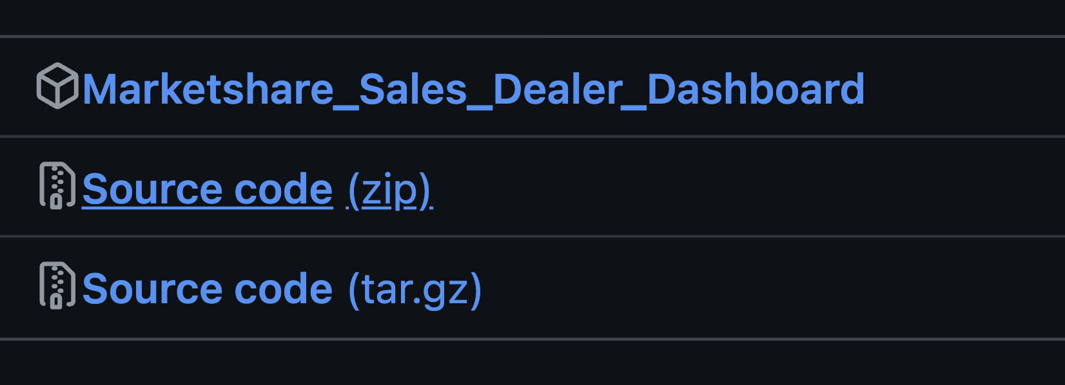
How to Use
Download Marketshare_Sales_Dealer_Dashboard file Then run the program by double clicking it
Ensure all data files are in same folder as program

Slide 3
Market share/Sales/LTA Dashboard Program

Slide 4
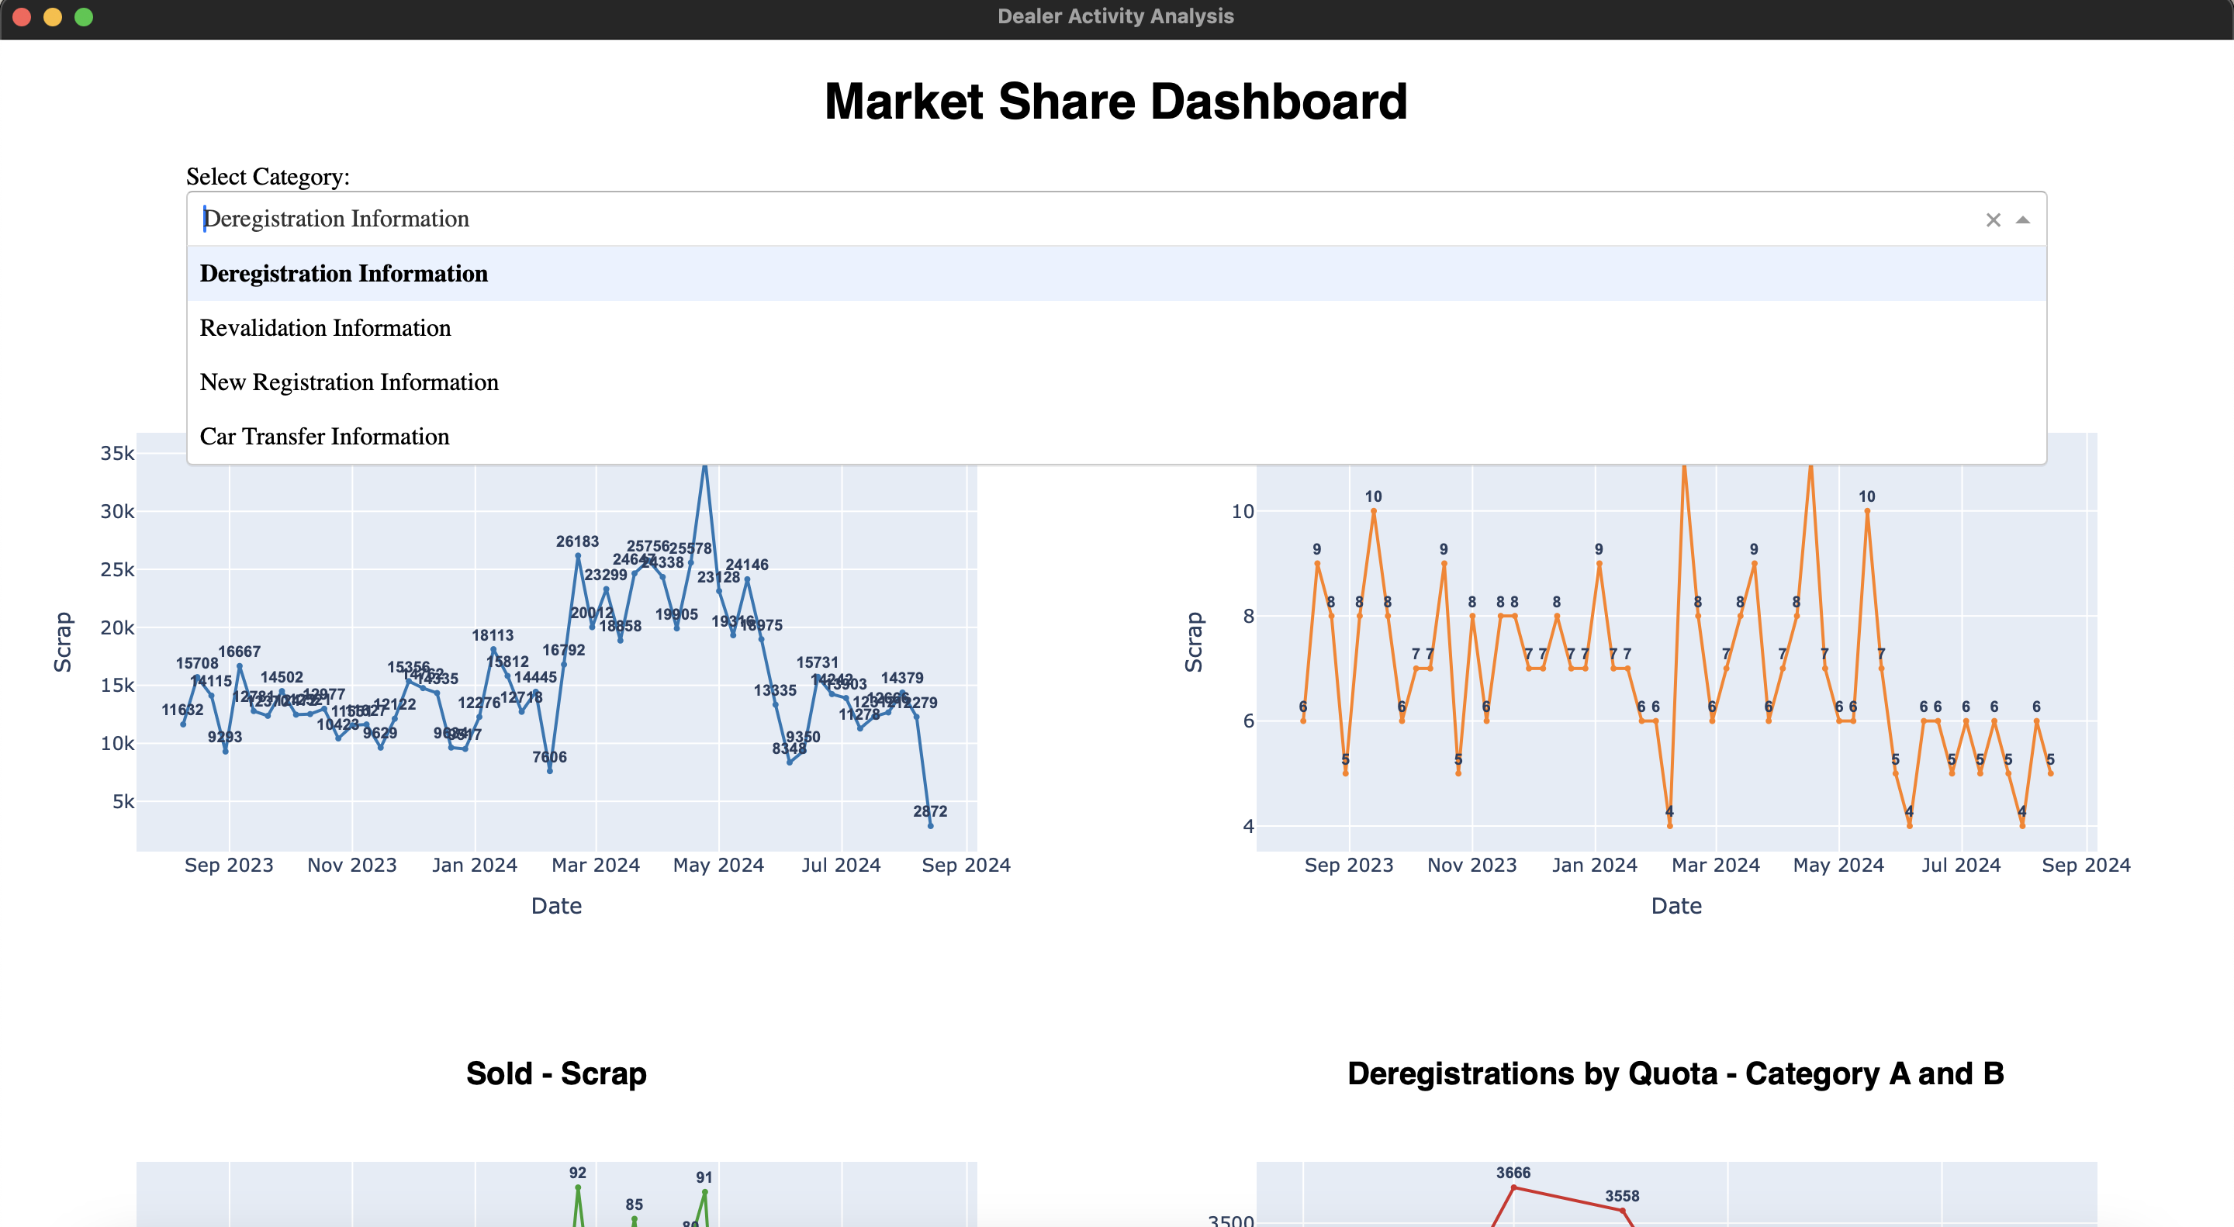
How to Use
Select the dataset you want to look at

Slide 5
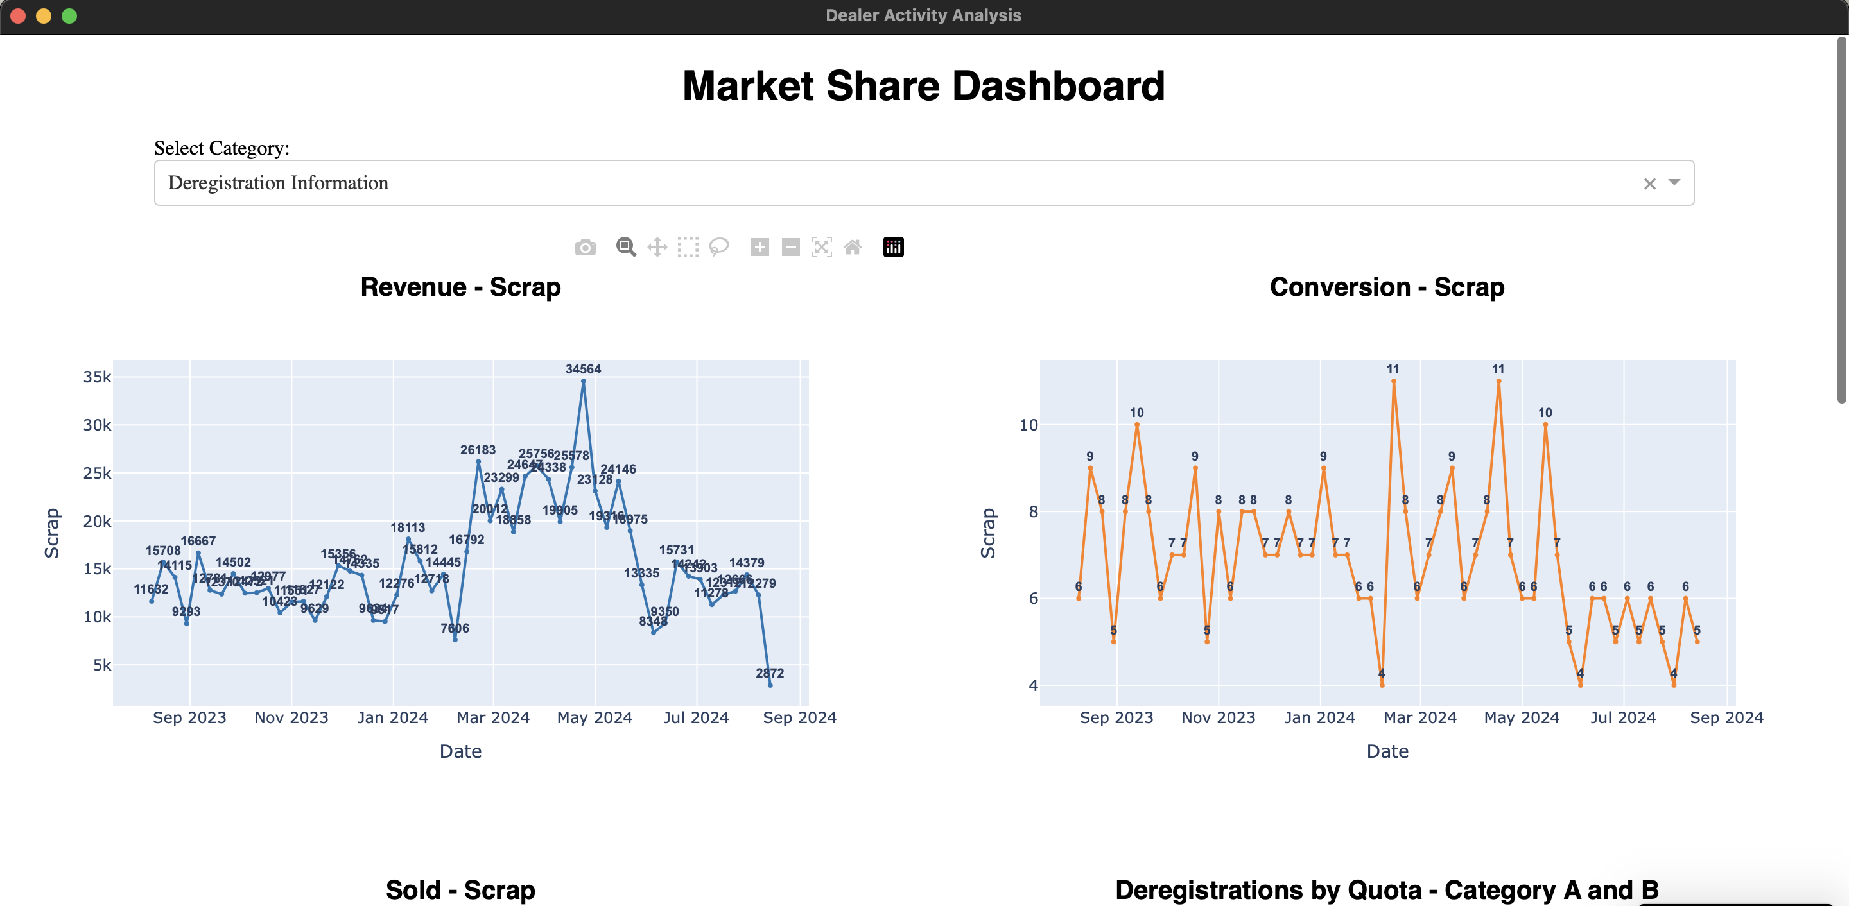
How to Use
Top half is the market share/sales data

Slide 6
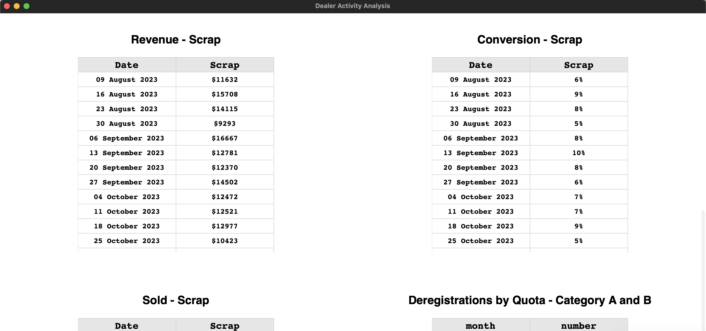
How to Use
Bottom half is the LTA data

Slide 7
Dealer Dashboard Program

Slide 8
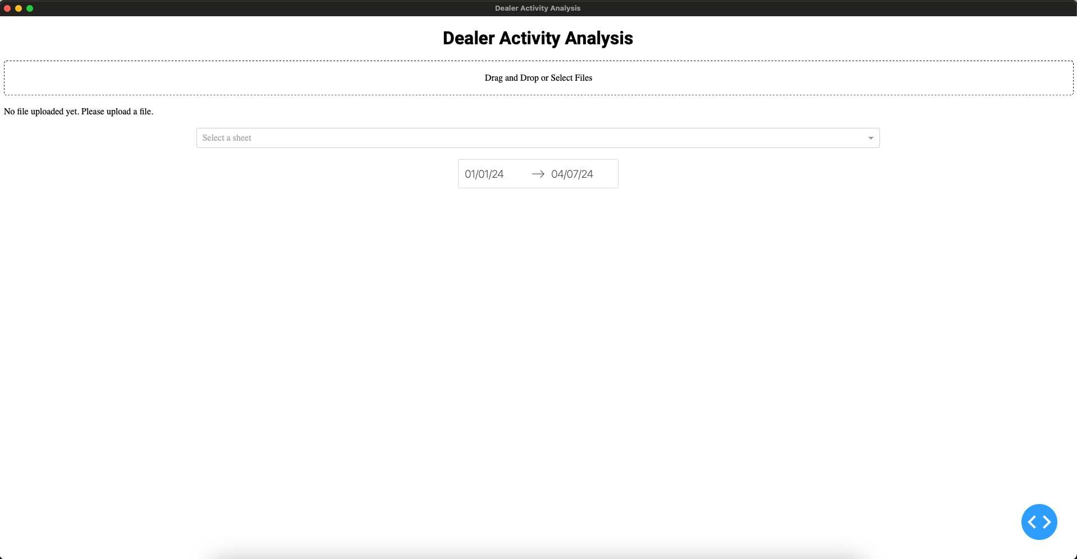
How to Use
This is the main screen of the program

Slide 9
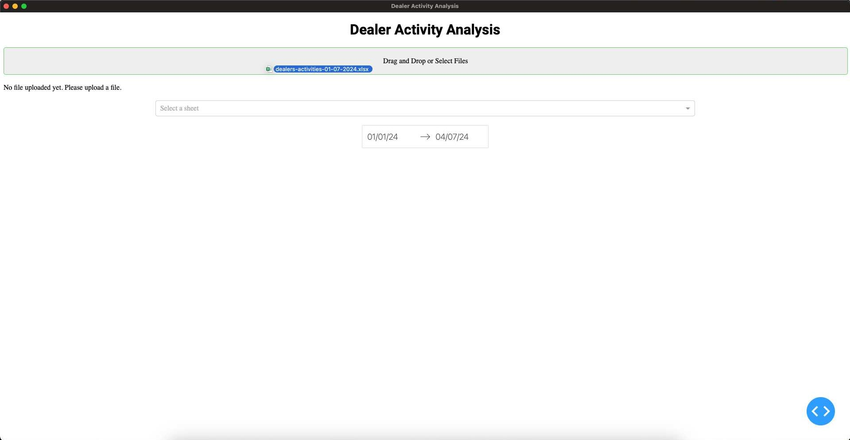
How to Use
Drag the Dealer Activities Data excel sheet into the dotted box

Slide 10
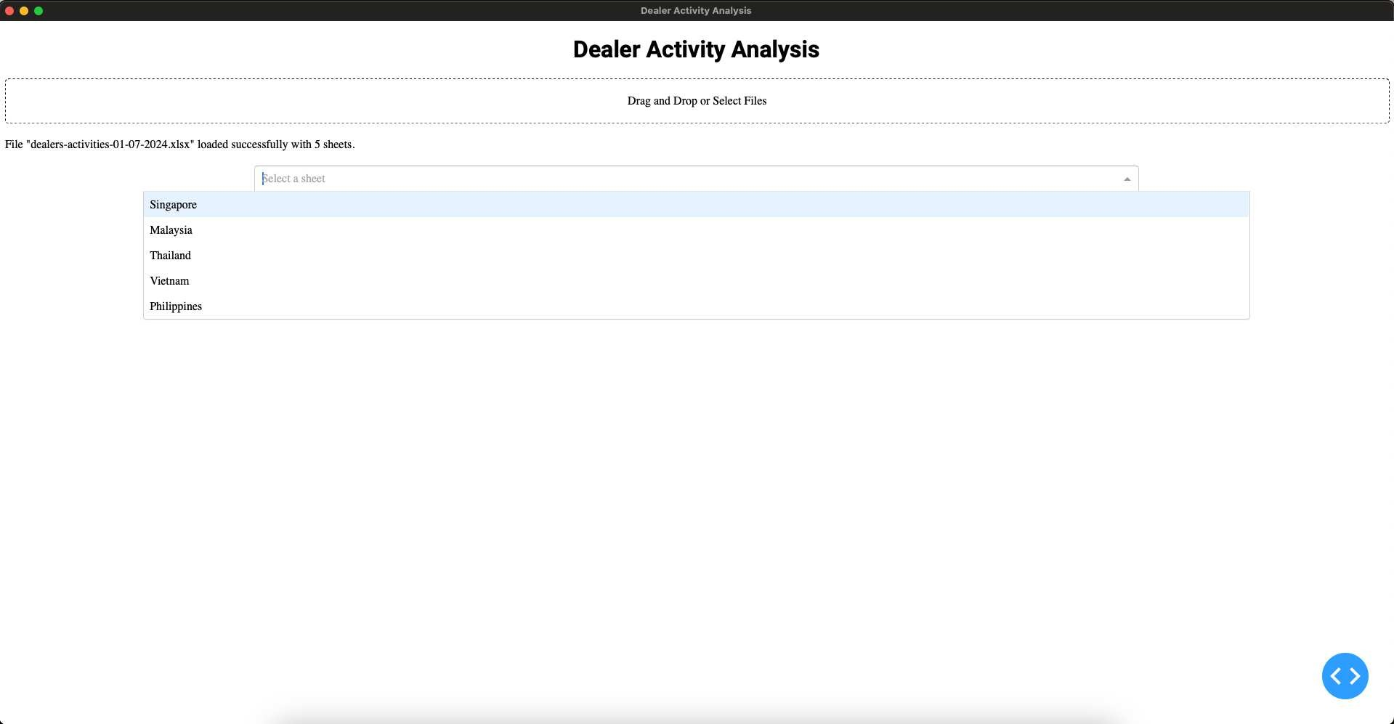
How to Use
Select the region

Slide 11
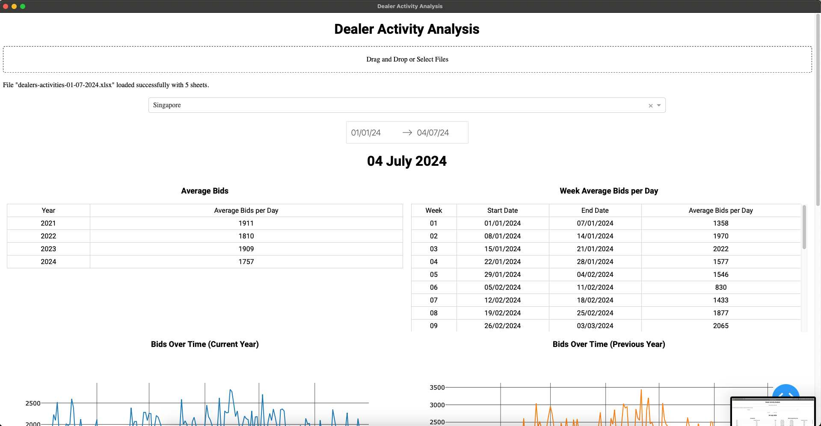
How to Use
After the loading animation, the dashboard will show.

Slide 12
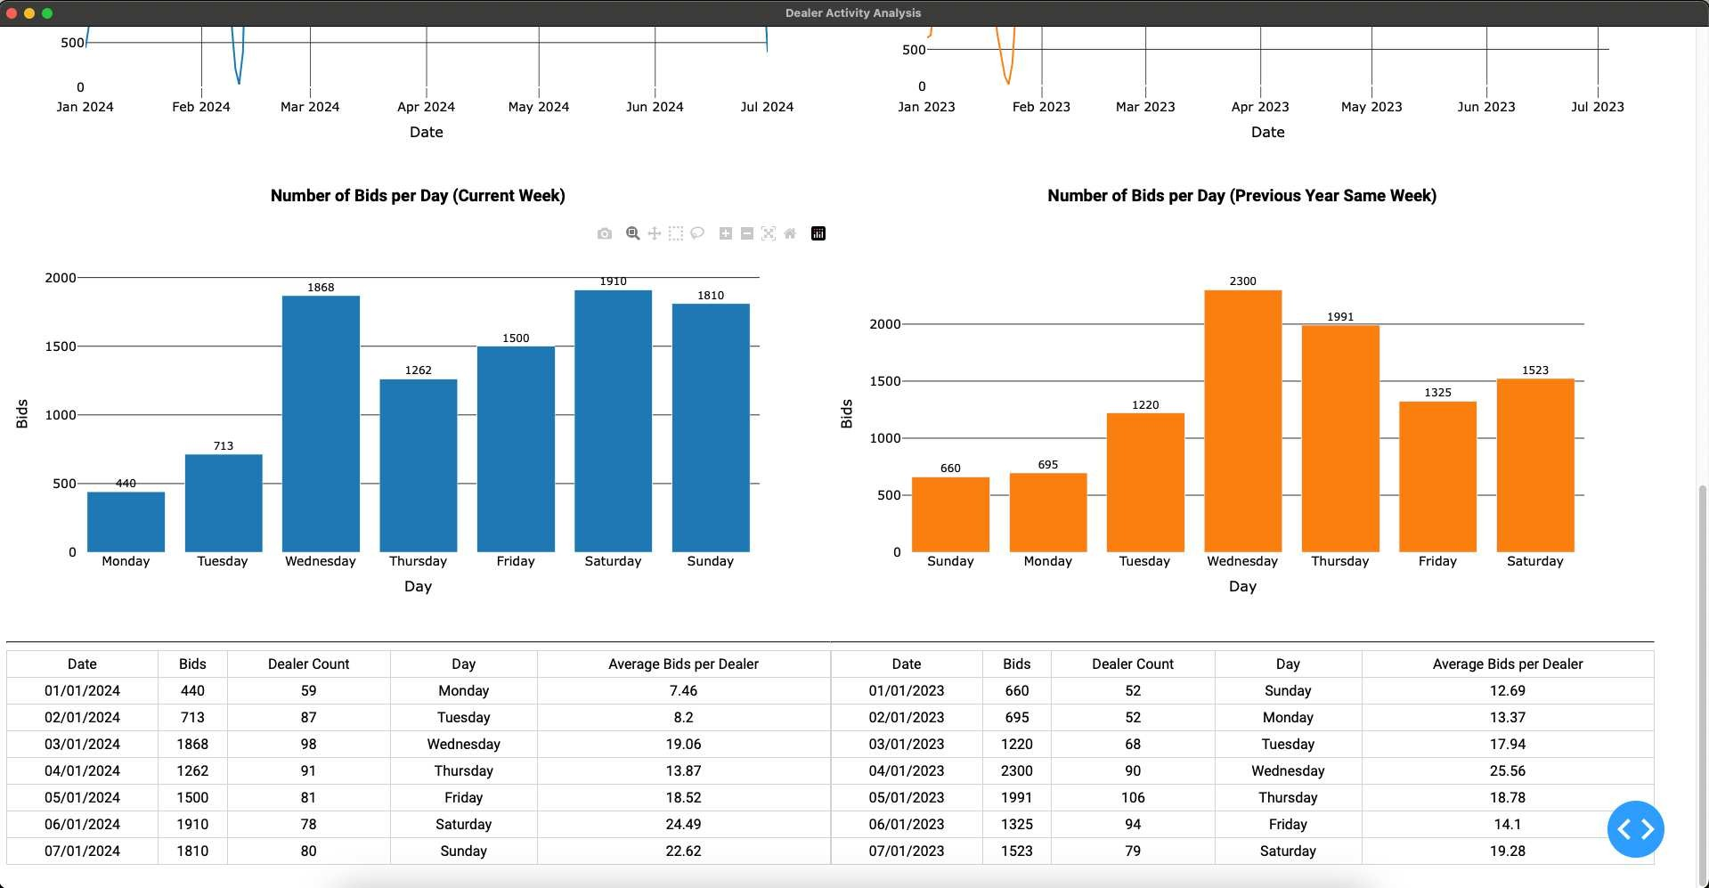
How to Use
The dashboard will default to show Week 1 of Current Year

Slide 13
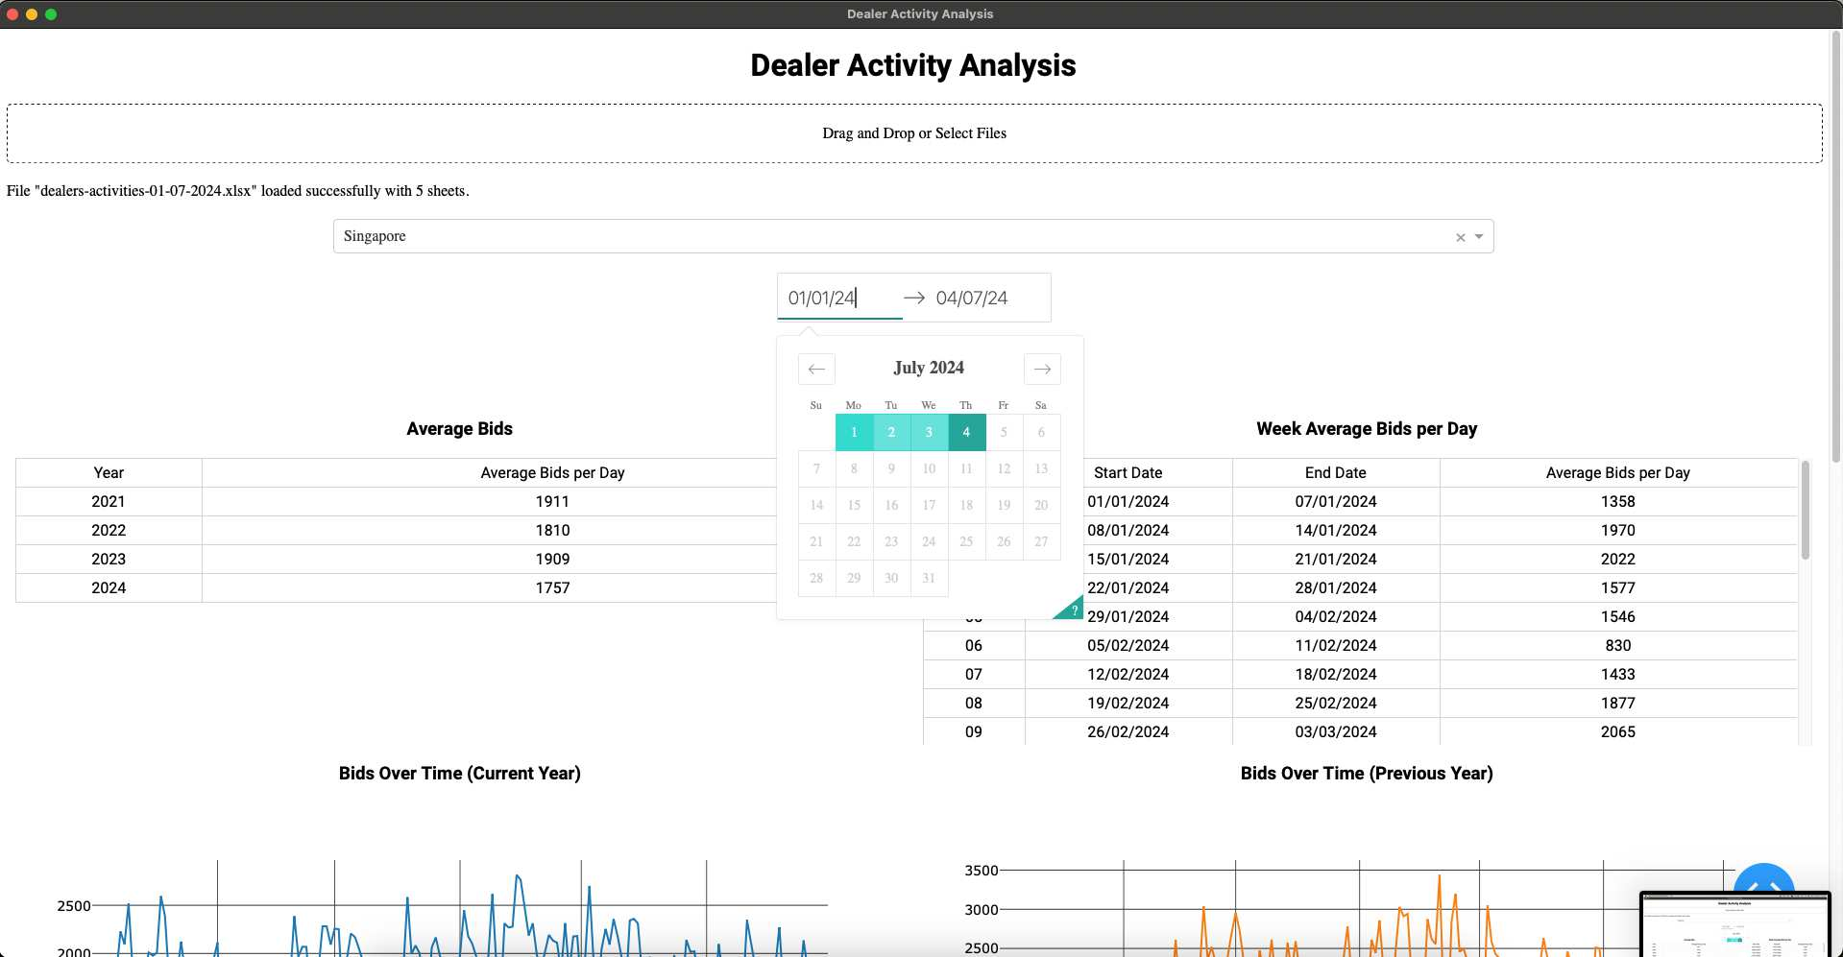
How to Use
Use the Date Range Picker at the top

